Slide 1


May 22nd, 2013
Standards Drive the Internet of Things
Zach Shelby, Chief Nerd
©Sensinode 2013

Slide 2
The Business Case
Cellular + WSN: Accessible market of 500 X more devices
  M2M players must look past just Cellular to grow
Enable new business models
Proprietary market >>> Global market
Rapid time to market = faster growth & lower cost
Truly inexpensive micro-controller & radio technologies
Re-use standard IT and Web infrastructure
Tap into a huge developer community (IP… Web…)
Permissionless Innovation!

Slide 3
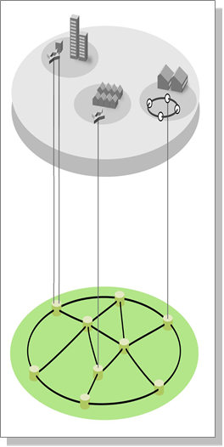
Is the Internet Protocol enough?
Web
100s - 1000s of bytes
XML
Services Layer
Inefficient content encoding
Web of Things
HTTP
10s of bytes
Huge overhead,
difficult parsing
Efficient Objects
Web Objects
TLS
CoAP
Efficient Web
Device Layer
TCP
DTLS
Requires full
Internet devices
Optimized IP access
UDP
IPv6
6LoWPAN
Internet
Internet of Things

Slide 4
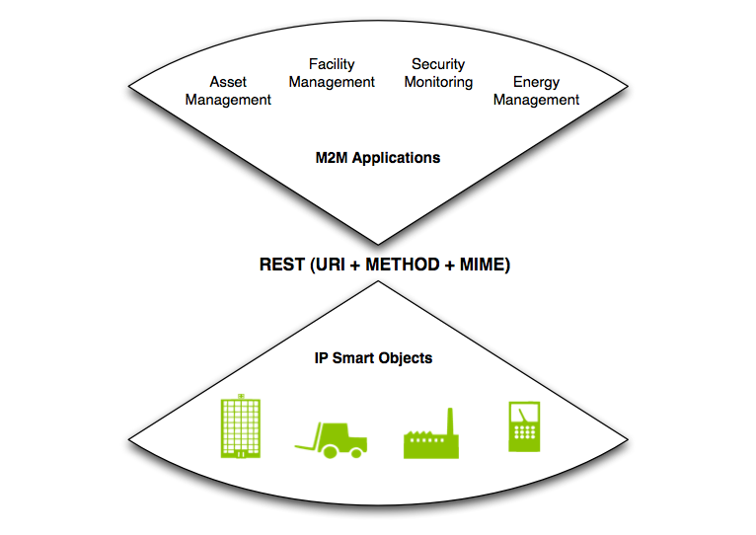
The Web of Things

Slide 5






Key Standardization Activities
IETF
  IPv6 and 6LoWPAN networking
  Routing algorithms (e.g. RPL)
  Web of Things (REST for IoT, CoAP, Resource Directory etc.)
  Security (DTLS, TLS, Cipher suites)
OMA / IPSO Alliance
  OMA Lightweight M2M Enabler Standard (CoAP)
  IPSO Web Objects
OneM2M
  Ongoing work on M2M system standardization (CoAP, HTTP binding)
ZigBee & WiSun
  ZigBee IP - An open-standard 6LoWPAN stack for Home Area Networks
  ZigBee IP NAN – 6LoWPAN stack for Sub-GHz large area applications
  WiSun - Sub-GHz 802.15.4g/e and 6LoWPAN consortium

Slide 6
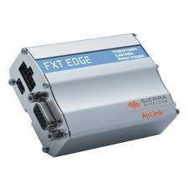
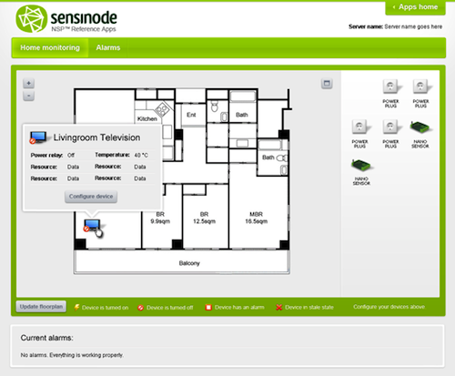
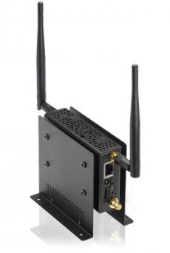


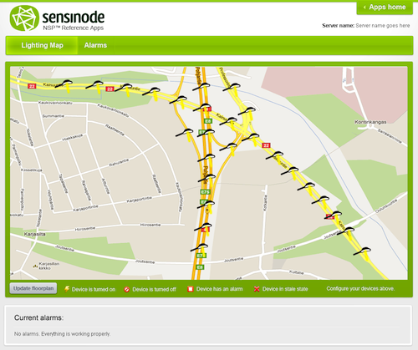
How to Build a Web of Things?
Cellular
6LoWPAN,
ZigBee IP,
CoAP / DTLS
Web Applications
HTTP / TLS
Lightweight M2M
CoAP / DTLS
AAA,
Admin
Billing
M2M Devices
Backend – Private or Public Cloud

Slide 7

The 6LoWPAN Map
Building Area Networks
Neighborhood Area Networks
ZigBee NAN
ZigBee IP
ISA 100.11A
Home Area Networks
Industrial Control

Slide 8
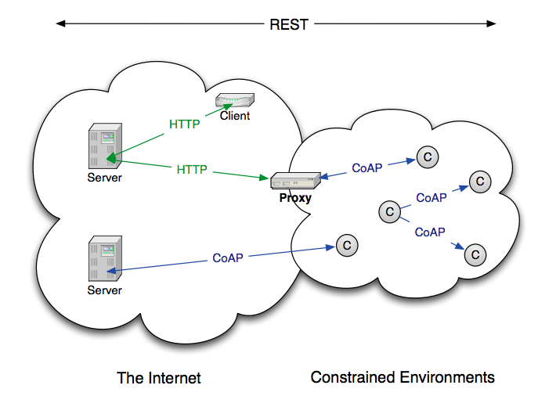
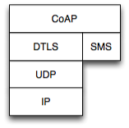
CoAP: The Web of Things Protocol
Compact 4-byte Header
UDP, SMS, (TCP)
DTLS Security
Subscription
Discovery
©Sensinode 2013

Slide 9
IPSO Web Objects
We need semantics to build a Web of Things
IPSO defines Web Object guidelines (join us!)
IPSO Application Framework published in 2012
New IPSO Web Objects will be published soon!
  Compatible with OMA Lightweight, CoAP and HTTP
  General purpose IO
  General sensors, Temperature, Light, Humidity, Actuators
  Light control, Power control, Set Points
Great roadmap of Objects for the future, e.g.
  Smart Cities
  Connected Home

Slide 10
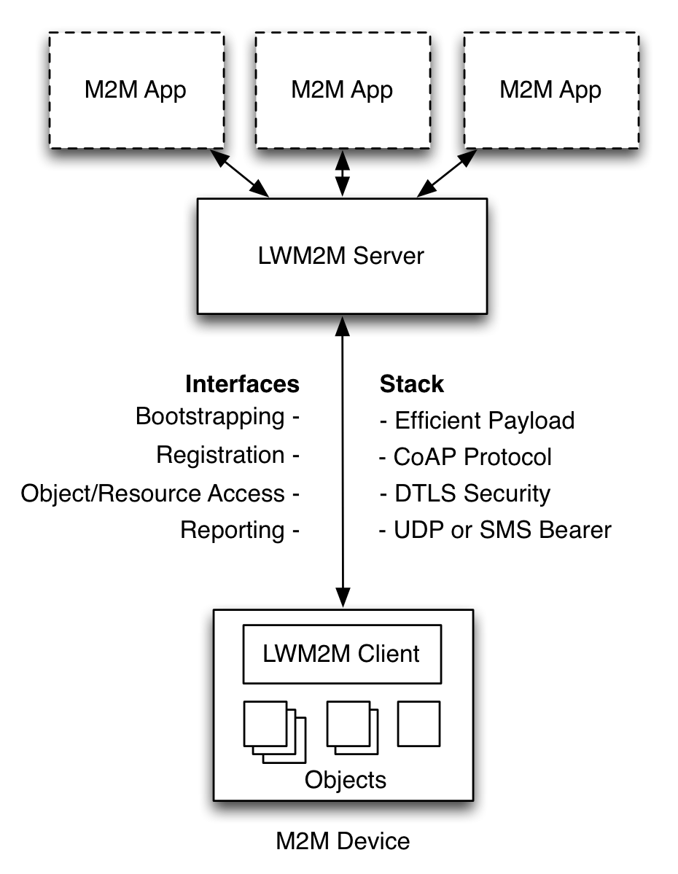
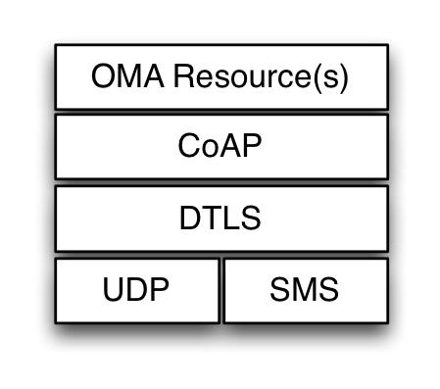
OMA Lightweight M2M
©Sensinode 2013

Slide 11
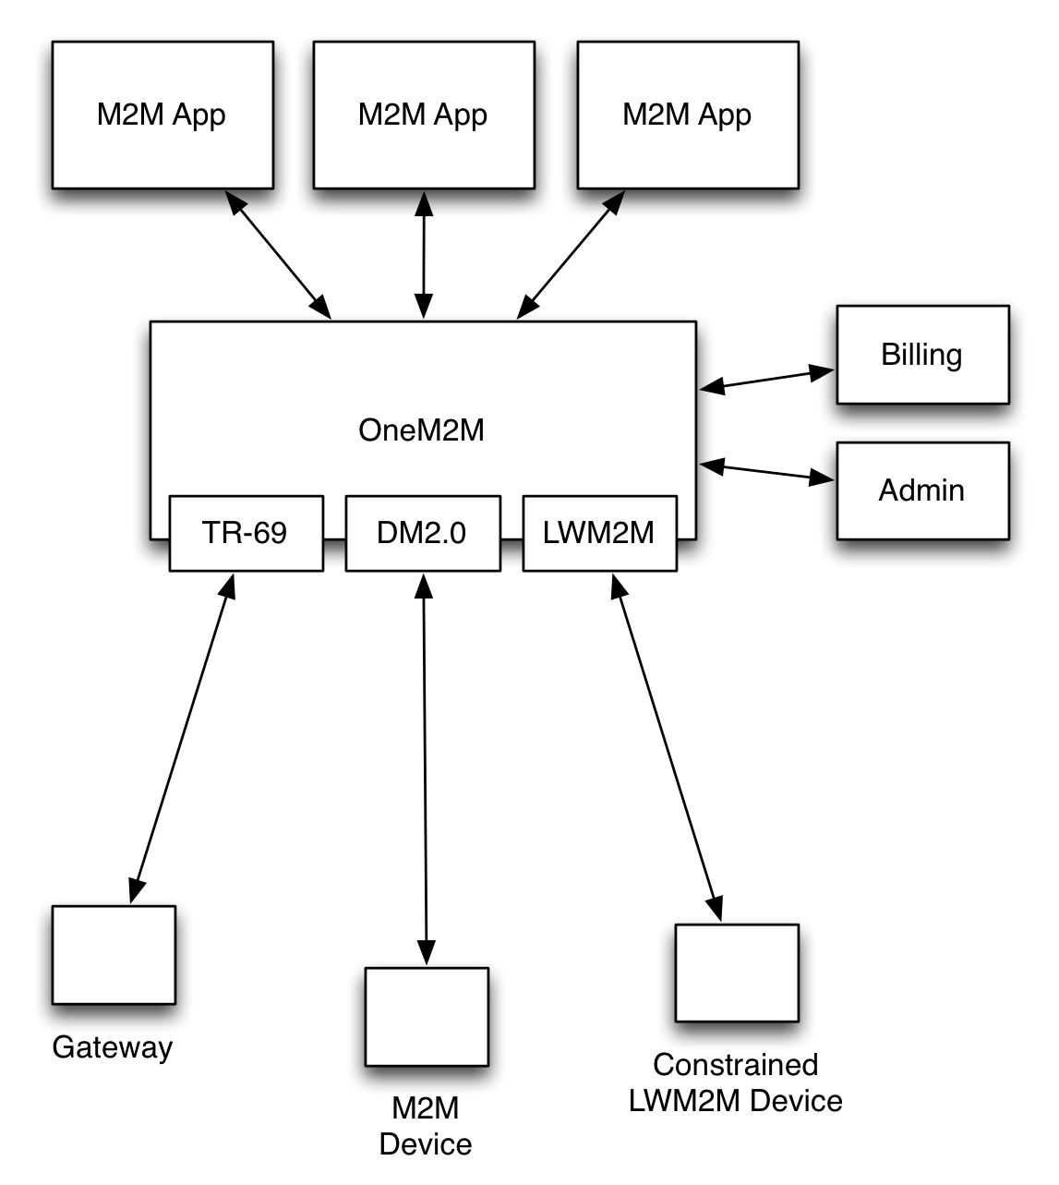
OneM2M

